Slide 1

Leading a terrorist attack with a drones swarm : Nightmare or reality ?
Drone demo dag voor veiligheidsdiensten
Zedelgem, 23 Rd November 2016
John Pyrgies
john.pyrgies@gmail.com
0476 / 40 11 72

Slide 2
Context
The Riga declaration on drones, issued on 6 th March 2015, states :
‘Drones also pose potential security risks. The design of drones can and should take into account those risks by using methods such as cyber-defence or geofencing. However, the malicious use of drones cannot be entirely prevented by design or operational restrictions’.
-> ‘It is the task of the national police and justice systems to address those risks’
The Royal Military Academy has been requested by the Belgian Interior and Defense ministries to deliver an opinion about the potential risks represented by drones in the preparation or execution of a terrorist attack

Slide 3
Bayesian inference
Bayesian inference is a method used to update the probability for an hypothesis H as an evidence E is acquired according to :
P(H | E) = P(E | H) . P(H) / P(E)
Where :
P(H) is the prior probability i.e. the probability of H before E is observed
P(H | E) is the posterior probability i.e. the probability of H after E is observed and thus the probability that the hypothesis H verifies given the observed evidence E
P(E | H) is the likelihood of observing E given H i.e. the compatibility of the evidence with the given hypothesis
P(E) is the probability to observe E, independently of H
Source : Wikipedia

Slide 4
Risk Model
Risk = Threat ∗ Vulnerability ∗ Consequence
Where :
Threat = P(attack occurs | Signals)
Vulnerability = P(attack results in damage | attack occurs)
Consequence = E (damage | attack occurs and results in damage)
Sources : Risk Analysis, Vol. 22, N° 3, 2002. Fusion of Intelligence Information: A Bayesian Approach - Elisabeth Paté-Cornell, RAND - Center For Terrorism Risk Management Policy, 2005.
Estimating Terrorism Risk Stanford University, Department of Management Science & Engineering, 2005. Risks of Terrorist Attacks, Probabilistic assessment and use of intelligent information - Elisabeth Paté-Cornell

Slide 5
Threat of an Attack
The Threat of an Attack can be modeled according to :
Threat = P(Attack Scenario | Signalsi)
and represents the probability that an attack scenario is executed (hypothesis verifies) given a set of Signalsi (the observed evidence)
An attack scenario is an attack launched against a specific target located in a specific geographic area with a specific weapon using a specific mean of delivery during a specific time period
Sources : Risk Analysis, Vol. 22, N° 3, 2002. Fusion of Intelligence Information: A Bayesian Approach - Elisabeth Paté-Cornell, RAND - Center For Terrorism Risk Management Policy, 2005.
Estimating Terrorism Risk Stanford University, Department of Management Science & Engineering, 2005. Risks of Terrorist Attacks, Probabilistic assessment and use of intelligent information - Elisabeth Paté-Cornell

Slide 6
Targets type
Symbolic monuments, Government buildings and representatives
Business districts, skyscrapers, stock exchanges, hotels and casinos, airports, nuclear power plants
Military, train and subway stations, stadiums, bridges and tunnels
Industrial facilities, oil and gas processing facilities, tourist attractions, shopping malls, restaurants, ports and ships
Media HQ, Fortune 100 HQ, theaters, major entertainment centers, gas stations
Cruise ships, apartment buildings, foreign consulates, European institutions
Water reservoirs and distribution, passenger trains, airspace zones
Power plants, dams, railway networks
Source : RAND - Center For Terrorism Risk Management Policy, 2005. Estimating Terrorism Risk

Slide 7
Geographic area
All the countries of the European Union…
But… France and Belgium are recurrently under the terrorist attacks from ISIS

Slide 8
Time period
6 months

Slide 9
Weapons type
Explosive (ex TNT)
Nuclear
Biological (ex anthrax)
Chemical (ex sarin gas)
Radiological (ex Cesium 137)
Firearms
Air-to-surface missiles
Source : RAND - Center For Terrorism Risk Management Policy, 2005. Estimating Terrorism Risk

Slide 10
Means of delivery
Producer & Designation | RPAS Type | Max Payload (Kg) | Range (Km) | Endurance (H) | Max Speed (Km/H) | Price (€)
DJI Phantom 3 | Micro | < 0,2 | 2 | 0,383 | 57 | < 1000
Draganflyer X8 | Micro | 0,8 | 1,5 | 0,33 | 50 | > 30 000
Infotron IT180-5TH | Mini | 5 | 10 | 2 | 90 | > 60 000
Iran AMI Ababil-S | Close Range | 45 | 100 | 4 | 200 | ?
Source: Blyenburgh & Co - UVS - RPAS Yearbook 2015, 13 Th Edition + Producer web sites

Slide 11
Some Realistic RPAS Attack Scenarios
RPAS Attack Scenarios | Mean of Delivery RPAS Type | Target | Weapon | Geographic Area | Timeframe
Scenario 1 | Micro | Summit with personalities (eg COP22, EU…) | Explosive | France, Belgium, Europe | within 1 year
Scenario 2 | Micro | Stadium (with mass gathered and personalities) | Chemical/Biological | France, Belgium, Europe | within 1 year
Scenario 3 | Micro | National day parade (with mass gathered and personalities) | Explosive | France, Belgium, Europe | within 1 year
Scenario 4 | Micro | Airport (jetliner) | Explosive | Europe | within 1 year
Scenario 5 | Mini | Ports and ships (eg gas tanker in Antwerp | Explosive | Europe | within 1 year

Slide 12
Attractivity for terrorists
Attractivity of drones swarm as an attack vector:
  Hit very protected personalities (EU summit)
  Hit masses protected by a security perimeter (Euro football match)
  Hit very protected personalities AND masses (national day parade)
  Symbolic Aspect : ISIS retaliates coalition drones attacks with drones

Slide 13
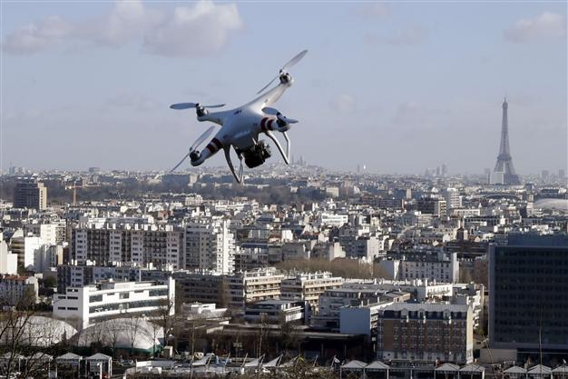
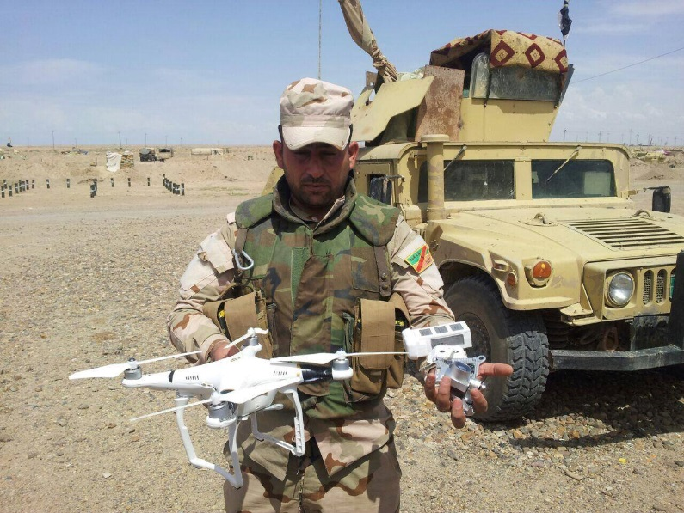
Signals
Signals1 (2015) : Illegal drone flights over Paris and strategic sites (nuclear plants, submarine bases…) in France and Belgium
Signals2 (May 2016): ’Commercial micro-drones transformed into flying Improvised Explosives Devices (IED) discovered in ISIS arsenals captured by coalition forces’
Signals3 (October 2016): An ISIS IED drone has seriously wounded 2 French paratroopers at Erbil (Irak)
Sources: Bloomberg News 7 Th July 2016 – Le Monde 11 Th October 2016 – Photo Nouvel Obs

Slide 14
Other Possible Attack Scenarii
Attack Scenarios | Mean of Delivery | Target | Weapon | Geographic Area | Timeframe
Scenario 6 | Pedestrian | Oil and gas Processing | Explosive | Europe | within 1 year
Scenario 7 | Pedestrian | Government building | Fireams | Europe | within 1 year
Scenario 8 | Car | Airport | Explosive | Europe | within 1 year
… | … | … | … | … | …
Drones can be used by terrorists to prepare those ‘conventional’ attacks as they could exploit this new way of performing reconnaissance activities
One shall assess : P(Attack Scenarioi | Reconnaissance by drone)

Slide 15
Countermeasures
Countermeasures are the technological and organizational means
Decreasing the probability the attack is launched (deterrence)
Threat = P(attack occurs | Countermeasures)
Decreasing the probability the attack succeeds
Vulnerability = P(attack results in damage | Countermeasures)
Limit the damages to an acceptable level
Consequence = E (damage | Countermesures)

Slide 16
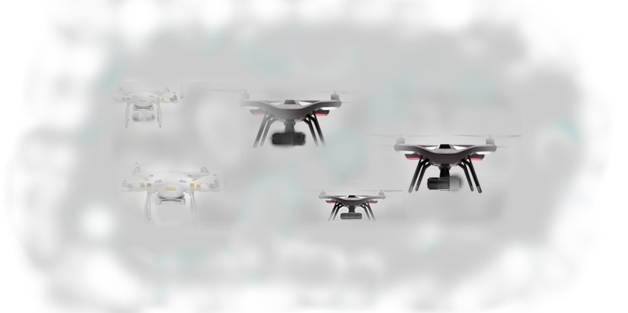

Countermeasures
Detection : One or several drones are approaching a protected asset
Classification :
  Identify : Friend or foe ?
  What type of drones ?
  (What type of payload ?)
Tracking : Follow up their trajectory
Interception : Act on them to protect their target AND avoid collateral damages

Slide 17
Detection : Radars
Conventional radars used in Air Traffic Management are not well suited to follow small, low flying, slow motion aircrafts like drones
Doppler Radar with electronic scanning Frequency Modulated Continuous Wave (FMCW) using a Passive Electronically Scanned Array (PESA) and operating on the KU band. Can be combined in multi-radars operations. Detects a Micro drone at ranges up to 2 KMs (Blighter A400 Series)
Doppler Radar operating on the X band. Can be combined in multi-radars operations (Kelvin Hughes SharpEye)
Doppler Radar operating on the X band with Frequency Modulated Continuous Wave (FMCW). Can be combined in multi-radars operations (Robin Elvira)
Radar with Frequency Modulated Continuous Wave (FMCW). Detects a Micro drone at ranges up to 5 KMs (Thales Squire)
Source: Blighter, Kelvin Hughes and Robin

Slide 18
Detection : Other technologies
Acoustic detection : Recognizes unique sound patterns of common drones types. Detects a Micro drone at ranges up to 1 KM. Not suitable to noisy urban environments (Droneshield, Drone Detector)
Thermal detection : Electric micro drones do not produce a lot of heat (Drone Detector)
Radio frequency detection : Allows to detect the signals emitted by the radio controller (commands) and the drone (telemetry). Detects a Micro drone at ranges up to 0,5 KM (Drone Detector)
Source: Drone detector

Slide 19
Classification : Cameras
Electro optical color camera : integration of multiple cameras, target classification based on color codes (Kelvin Hughes SharpEye, Chess)
Thermal imaging camera: Suitable for drones flying in bad weather conditions or in the darkness (Kelvin Hughes SharpEye, Chess)
Source: Kelvin Hughes, Blighter

Slide 20
’Good Drones’ identification
Real time flight tracking solutions: Unifly (BE), Dron House (PL) allows to identify the ‘good drones’ and provide their real-time position to aviation authorities
Police forces are thus in a better position to identify potentially ‘hostile’ drones as they have no recorded flight plan
Sources: Unifly, Dronhouse

Slide 21
Tracking : Video tracking
Video tracking technology tracks the trajectory of the drone. Track fusion from multiple sources (Kelvin Hughes SharpEye, hypercable Vidoc, Chess)
Source: Kelvin Hughes, Hypercable

Slide 22
Interception : RF Signals jamming
Disrupt the signals exchanged between the remote controller and the drone via the C2 link (Hypercable, Enterprise)
Triggers the Return To Home function of the autopilot
No effect on a drone flying an automatic mission with waypoints programmed in its autopilot and stored in its embedded memory and without connection to its remote controller
Source: Hypercable, Blighter

Slide 23
Interception : GNSS Signals jamming
Disrupt the GNSS signals reception by the drone (Enterprise , part of Blighter AUDS solution)
Depending on drone models: Triggers the Return To Home function of the autopilot… Make it hoover or… crash
Source: Blighter

Slide 24
Interception : GNSS Signals spoofing
Emit false GNSS scenarios (set of coherent signals) and mislead the drone into believing it is at an other location
GPS, Glonass and Beidou constellations
Range 2…To 100 KMs (Hypercable Clearsky coupled with the Bromur turret)
Can affect all rogue drones part of a swarm
! There are researches to allow drones navigating without GNSS (camera which recognizes landmarks and maps stored in the embedded memory of the drone, development of drones IMU…)
Source: Hypercable

Slide 25
Interception : AA technologies
Use Anti Aircraft (AA) Weapons to shot the drone down (50 mm drone killing Bushmaster cannon - fragmentation head, Thales Rapidfire cannon)
Use an Anti Aircraft infrastructure with High Energy Lasers (HEL) able to destroy a complete swarm of drones (Rheinmetall)

Slide 26
Interception : Other technologies
Capture the rogue drone with a net shoot from a portable ‘bazooka’ (SkyWall 100)
Capture the rogue drone with a net shoot from a from another drone (Excipio)
Capture the rogue drone with a… Royal eagle (Dutch police)

Slide 27
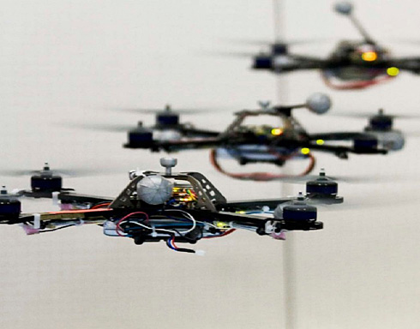
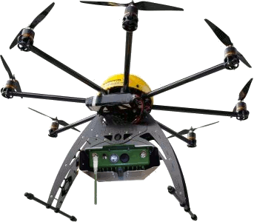
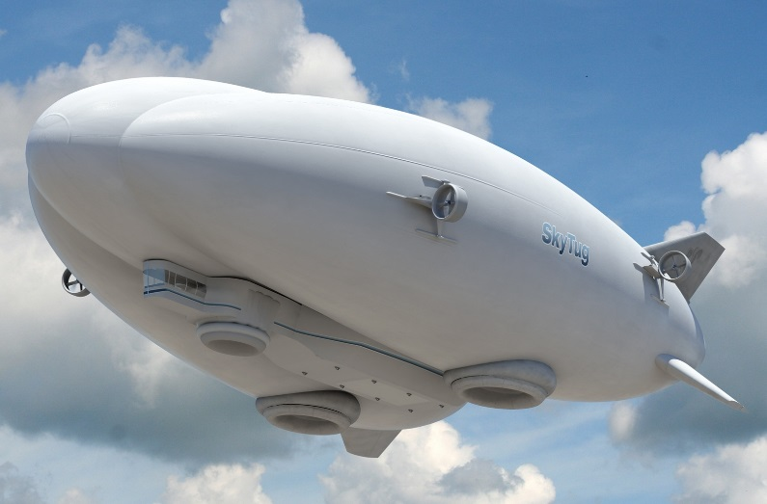
Approach proposed by SkyAngels
To neutralize efficiently and effectively a swarm of terrorist drones… The solution is a swarm of cooperative and autonomous drones …
That emit false GNSS scenarios with GNSS spoofers over the hostile drones to safely guide them to secure areas where their payload could explode…
And that are launched from drones carrier airships that also carry drones detection equipment
Sources: Hypercable ClearSky GNSS Spoofer - LTA ‘airstation’ UAS Carrier system from AIAA – Lookheed Martin hybrid airship

Slide 28
The challenges for the authorities
Integrate drones attacks in their risk model and keep it up-to-date :
Threat = P(drone attack occurs | Signals)
Vulnerability = P(drone attack results in damage | attack occurs)
Consequence = E (damage | attack occurs and results in damage)
and select and implement the most effective and efficient countermeasures :
Threat = P(drone attack occurs | Countermeasures)
Vulnerability = P(attack results in damage | Countermeasures)
Consequence = E (damage | Countermesures)
Sources : Risk Analysis, Vol. 22, N° 3, 2002. Fusion of Intelligence Information: A Bayesian Approach - Elisabeth Paté-Cornell, RAND - Center For Terrorism Risk Management Policy, 2005.
Estimating Terrorism Risk Stanford University, Department of Management Science & Engineering, 2005. Risks of Terrorist Attacks, Probabilistic assessment and use of intelligent information - Elisabeth Paté-Cornell

Slide 29
Next steps
Collect stakeholders requirements and formalize them in a ‘Product Requirements Document’ (what is an ‘anti hostile drones solution’ ? )
Architecture design and technical feasibility of the solution (how to build it ?)
Financial aspects : Investments, operating costs and revenues (Business case)
Find public and private sector partners

